Slide 1
CASE REPORT

Slide 2
F.M.M
46 years old
Admitted in K.N.H
28/09/2025

Slide 3
Presented with six month history of abdominal swelling.
No abdominal pain, no melena, no hematemesis, no nausea, no vomiting.
Had a productive cough of one month
No history of weight loss
No fevers, no history of chills

Slide 4
Had a pigtail catheter inserted at a peripheral facility for the asciting tapping – daily tapping of 3l of ascitic fluid straw colored for the last one month concurrent with albumin infusions – still rapid accumulation of the ascetic fluid.
Was referred to Kenyatta National Hospital for further management.
No underlying chronic condition
Allergic to Sulphur based drugs.
Does not drink alcohol
Does not smoke cigarettes

Slide 5
On Exam – Sick looking, wasted, bilateral pitting edema, no pallor, no jaundice, no cyanosis, no lymphadenopathy,
BP 120/80, PR 80 regular and palpable in all extremities Spo2 95% RA
PA – distended globally with pig tail catheter in situ – active in drainage – serous fluid , no pus from catheter site, not tender on palpation, shifting dullness and fluid thrill positive. Liver span 6cm BCM, splenomegaly
R/S – Bilateral reduced breath sounds with dullness on percussion – had a right chest drain in situ
Rest of exam normal

Slide 6
INVESTIGATIONS
Wbc | 6.75
Hb | 9.2 normocytic normochromic
Platelet | 250
Sodium | 133
Potassium | 3.4
Creatinine | 51
Urea | 3.9
T bilirubin | 7.4
D bilirubin | 3.7

Slide 7
AST | 32
ALT | 46
Albumin | 17
ANA | Positive
ENA | Positive for SCL 70
INR | 1.09
HIV | Negative
HepBsAg | Negative
Hep C Ab | Negative
C3 | 1.25
C4 | 0.301

Slide 8
Ascitic fluid analysis –
Cell count – no wbc, no rbc,
Ascitic fluid protein 13.5
Ascitic fluid albumin – 5.6
SAAG>1.1g/dl
Ascitic fluid MCS – No growth

Slide 9
Pleural fluid cell count – wbc 100, rbc 20,
Pleuaral fluid MCS – no growth
Pleural Fluid – exudative >0.6 ldh ratio, >0.5 protein

Slide 10
CT abdomen, pelvis with IV contrast – Portal vein thrombosis with features of portal hypertension, splenomegaly, ascites
HRCT chest – bilateral pleural effusion with right middle lobe emphysema
2d echo cardiogram – normal left ventricular systolic function EF 65% no regional wall motion abnormality, PASP 25mmhg, Grade 1 diastolic dysfunction

Slide 11
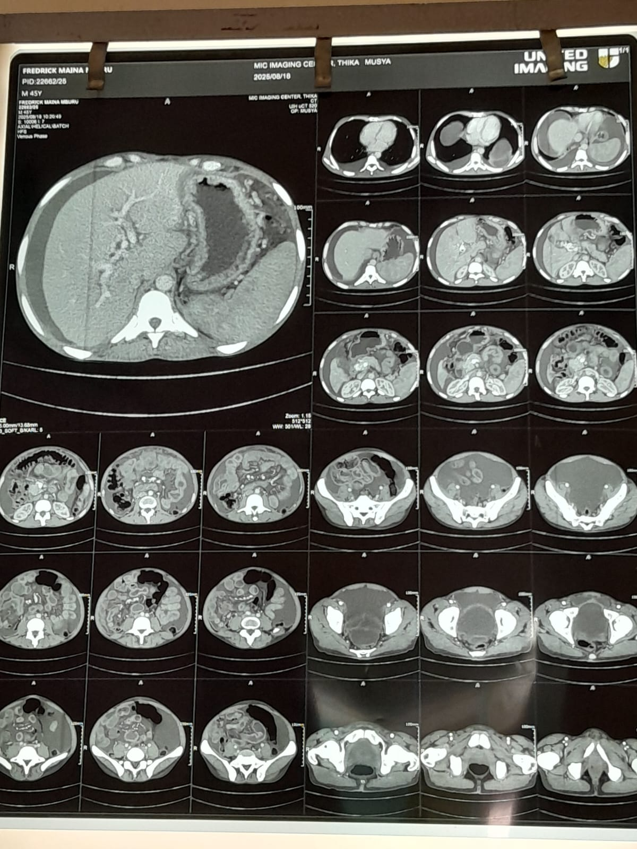

Slide 12
TREATMENT
Aldactone 100mg po od
Lasix 40mg po od
Albumin 100ml iv tds
Tapping every day 3l of ascitic fluid
Xarelto 20mg po od
Pantocid 40mg po od

Slide 13
Despite this has rapid accumulation of ascites
Benefit of TIPS yet portal vein obstruction is a relative contraindication?
Other options for the patient
Pending tests – ogd

